Slide 1
Assign Taxonomy
CHEN ZIXIA
CSBL
Apr. 15, 2024

Slide 2
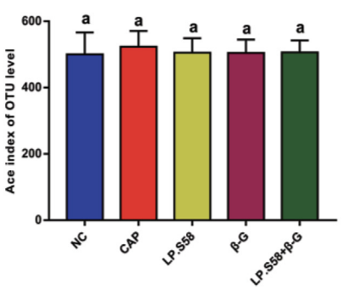
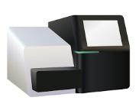
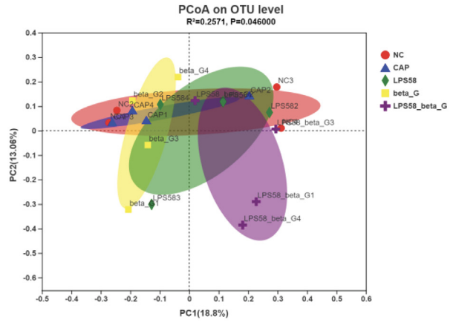
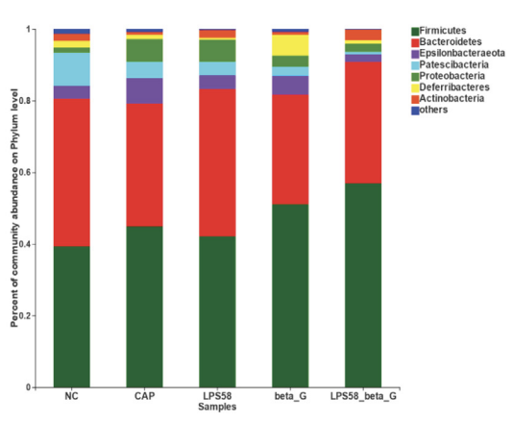



Steps in microbial diversity analysis
α diversity
(1)
Sample collection and DNA extraction
High-throughput
sequencing
ASV
ASV1
ASV2
ASV3
ASV4
β diversity
Amplify DNA
Data processing, quality control and analysis using bioinformatic tools
ASV taxonomy analysis
bacterial communities
……
(1) Tian Tang, Jiajia Song, Jian Li, et al. Qingke β-glucan synergizes with a β-glucan-utilizing Lactobacillus strain to relieve capsaicin-induced gastrointestinal injury in mice, Int J Biol Macromol, 2021.

Slide 3
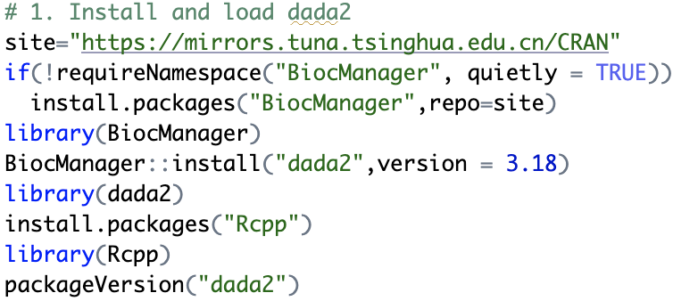

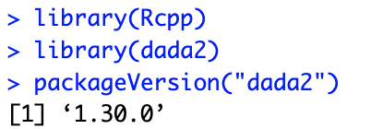
Notes:
Let me start with a brief overview of how and what microbial diversity data analysis is all about.

Slide 4
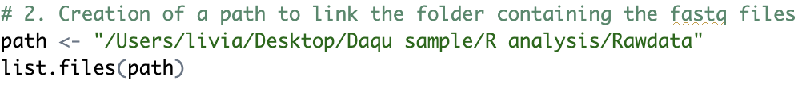
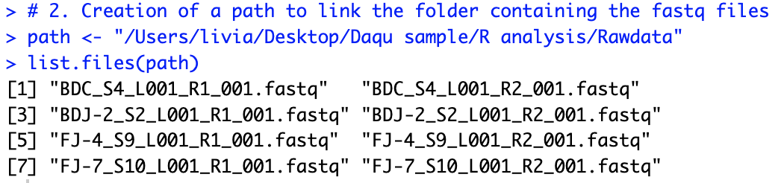
Notes:
Let me start with a brief overview of how and what microbial diversity data analysis is all about.

Slide 5
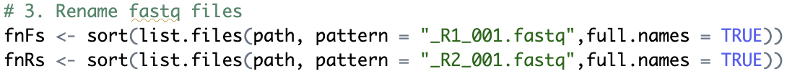
Notes:
Let me start with a brief overview of how and what microbial diversity data analysis is all about.

Slide 6
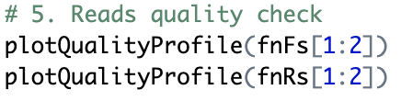
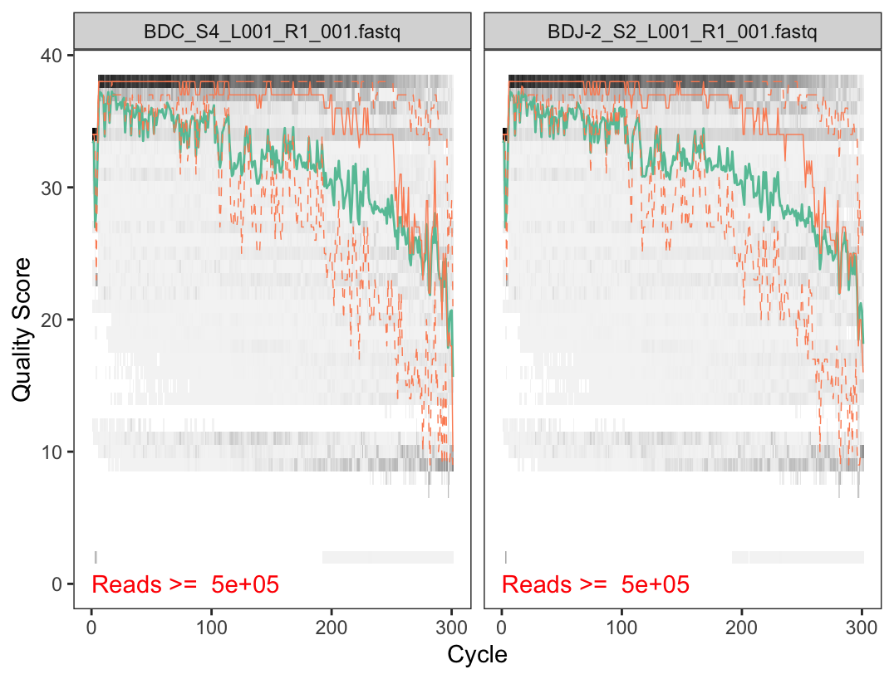
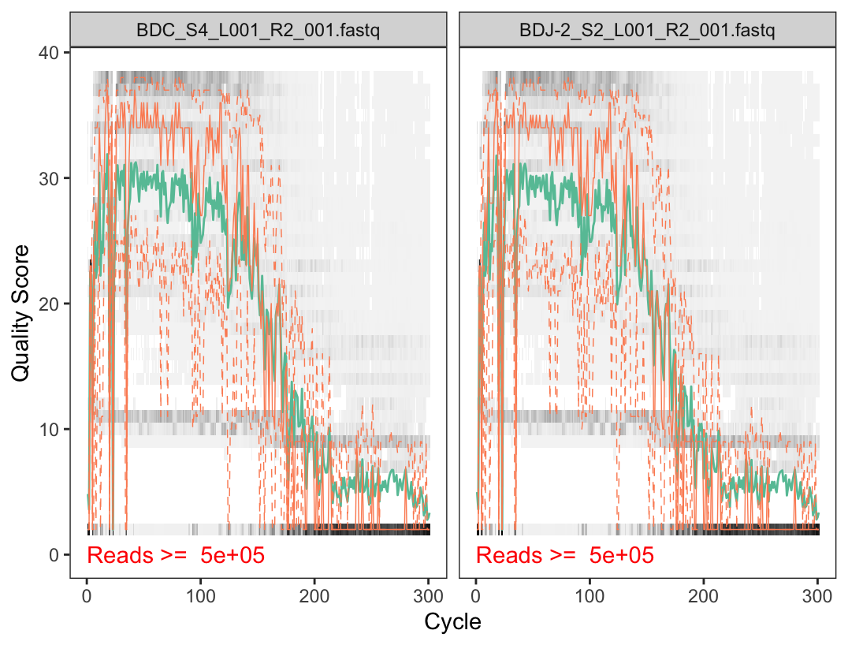
Notes:
Let me start with a brief overview of how and what microbial diversity data analysis is all about.

Slide 7
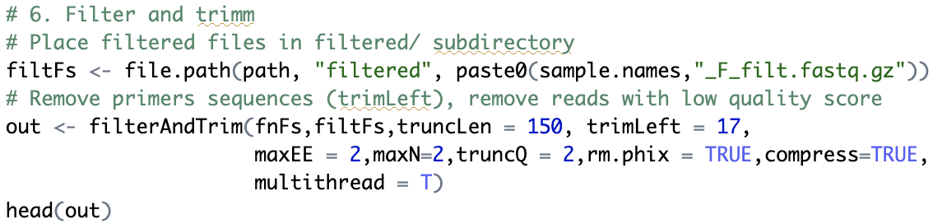
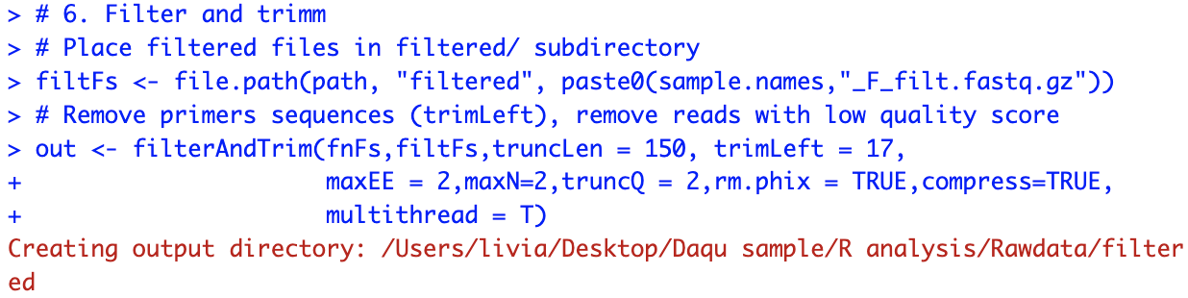
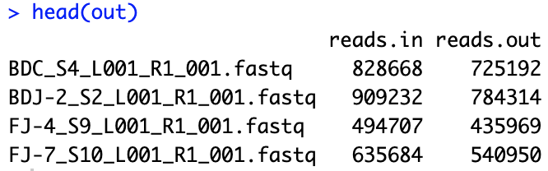
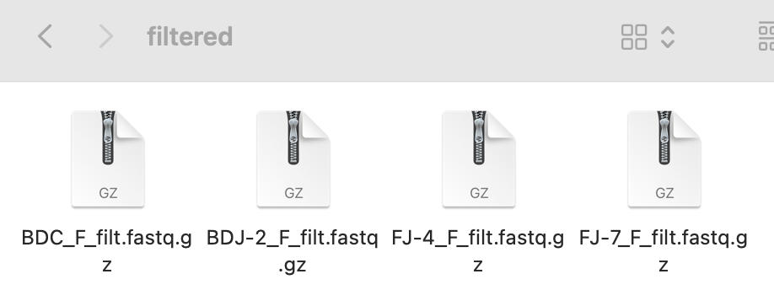
Notes:
Let me start with a brief overview of how and what microbial diversity data analysis is all about.

Slide 8
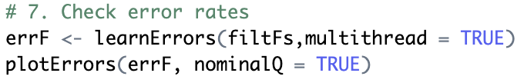
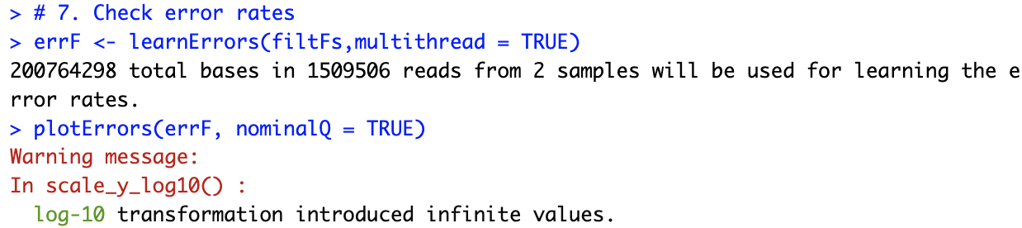
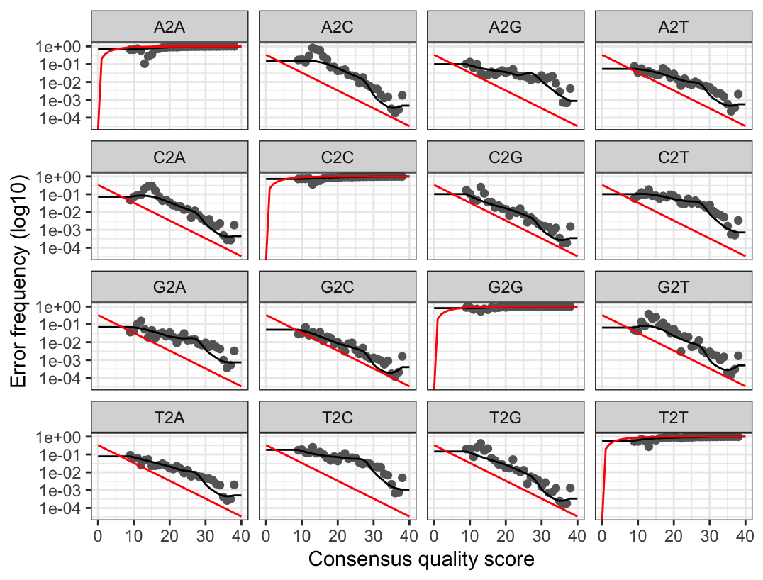
The dots in the figure indicate the observed error rate, the black line indicates the error rate obtained through algorithmic learning evaluation, and the red curve indicates the expected error rate by the definition of Q-score.
Notes:
Let me start with a brief overview of how and what microbial diversity data analysis is all about.

Slide 9
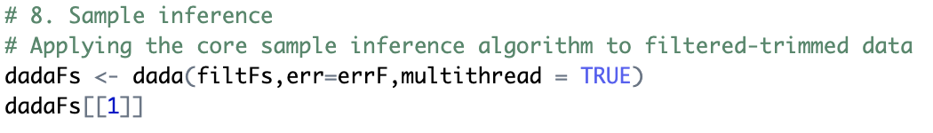
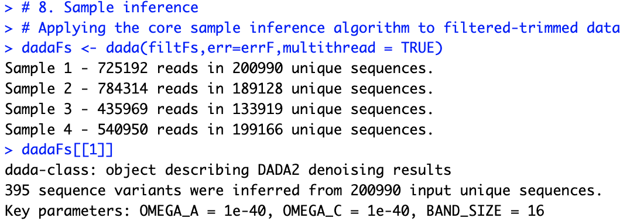
Notes:
Let me start with a brief overview of how and what microbial diversity data analysis is all about.

Slide 10
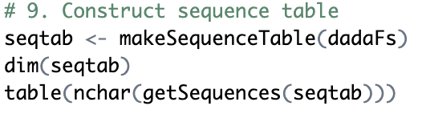
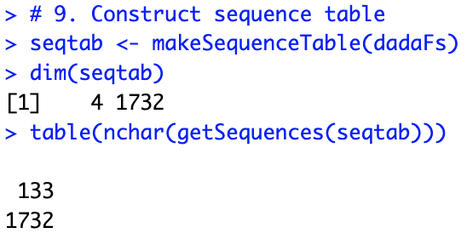
Notes:
Let me start with a brief overview of how and what microbial diversity data analysis is all about.

Slide 11
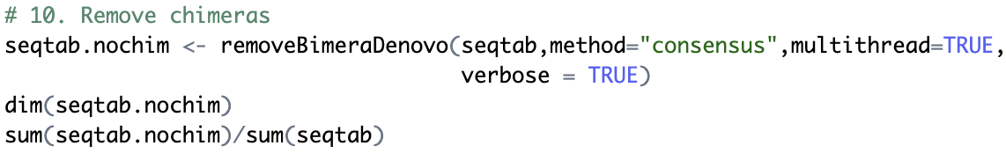
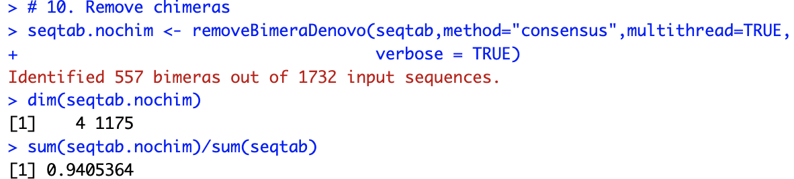
Notes:
Let me start with a brief overview of how and what microbial diversity data analysis is all about.

Slide 12
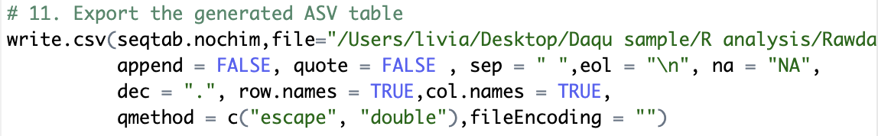
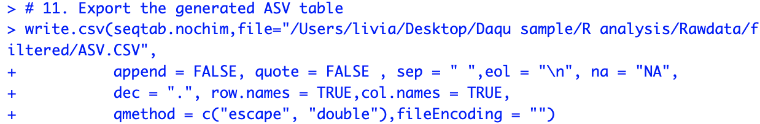


Slide 13
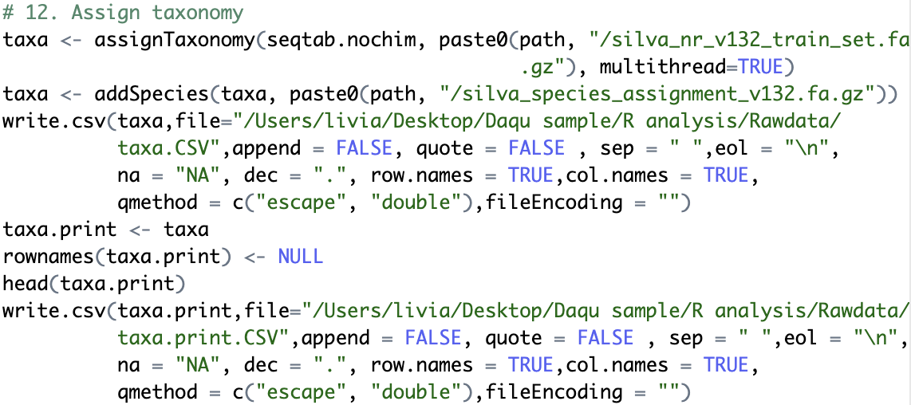
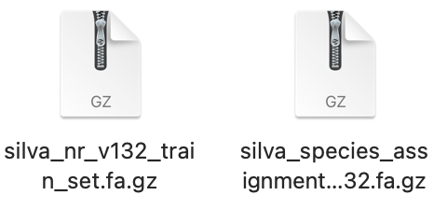
Download the database (http://benjjneb.github.io/dada2/training.html)
16S: Silva 132/128/123，RDP trainset 16/14, Greengene 13.8；
ITS: UNITE

Slide 14
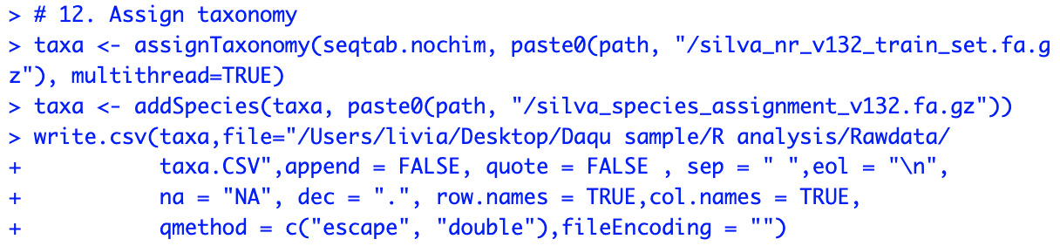
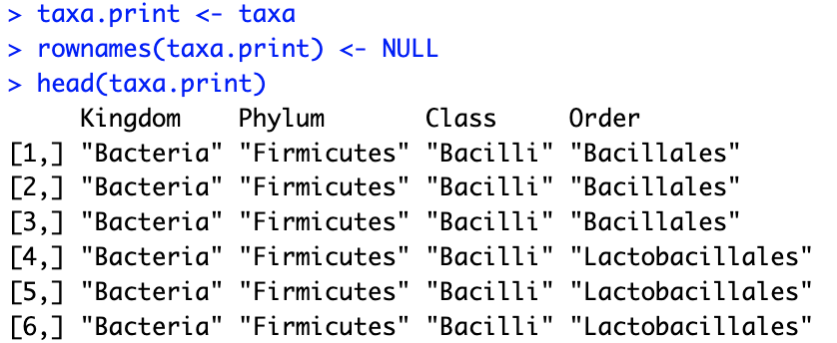
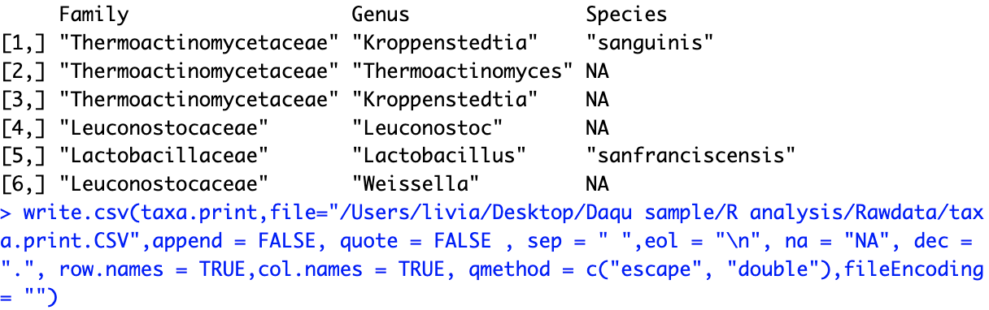

Slide 15
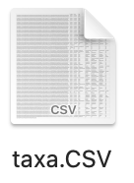
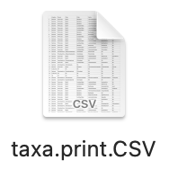
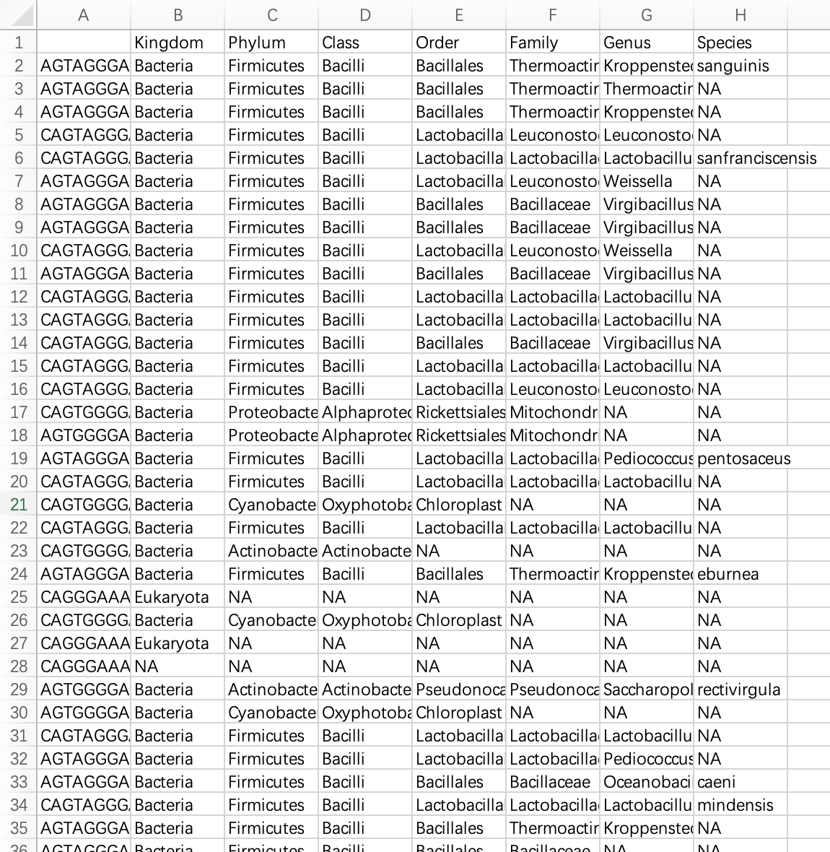
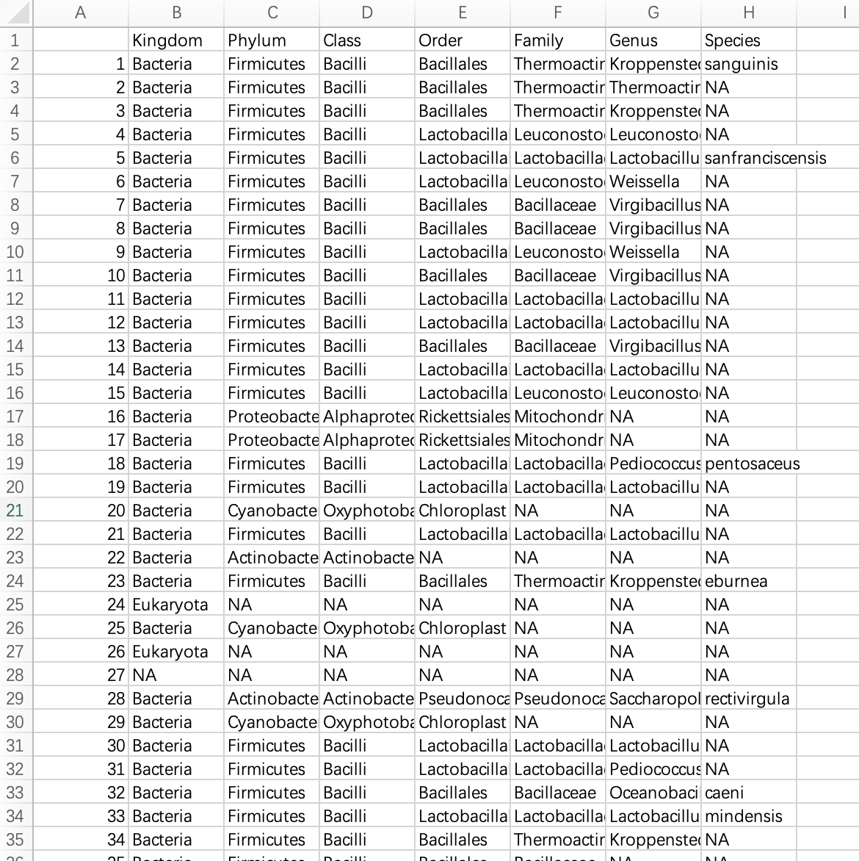

Slide 16
THANK YOU

